Slide 1




FATE
Fabrication Avoidance using Authentication and Encryption Techniques
Triple Threat
Nehal, Kaushik, M Jahnavi

Slide 2

Key Topics :
Integrity + Authentication
Attacks
Hybrid Approach - RSA + AES
Digital Signature
Kyber and Dilithium

Slide 3

Integrity
Authentication
Integrity ensures that data remains unaltered during transmission or storage. It prevents unauthorized modifications and guarantees that the received information is exactly as intended.
Authenticity verifies the identity of the sender or source of information. It ensures that the data comes from a trusted entity and has not been forged or tampered with.

Slide 4

Attacks
01
02
03
Passive Attack
Packet Sniffing
Active Attack
Modification
Active Attack
Fabrication

Slide 5
Hybrid Approach

Slide 6
Audio Encryption
Integrity : Hybrid Approach (AES + RSA)
Authentication : Digital signature with SHA-256 hashing
AES:
Symmetric Key Encryption
Block Cipher
AES-128 → 10 rounds
AES-192 → 12 rounds
AES-256 → 14 rounds

Slide 7
Key Schedule Algorithm
SubBytes
AES
Encryption
ShiftRows
Round 1
K1
MixColumns
AddRoundKey
Round 2
K2
Key
Inverse SubBytes
AES
Decryption
Inverse ShiftRows
Round n
Kn
Inverse MixColumns
AddRoundKey

Slide 8

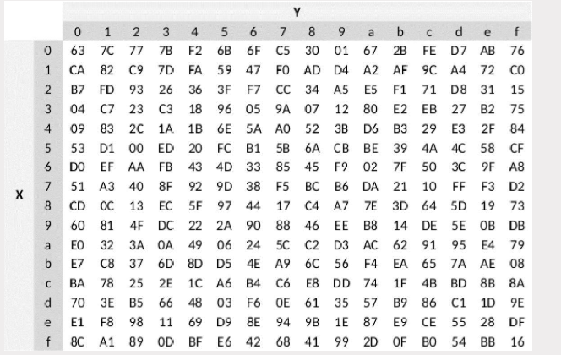
S-Box

Slide 9
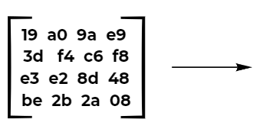
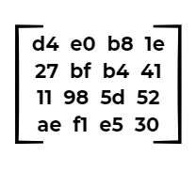
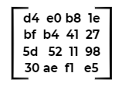
Step 1: SubBytes
Step 2: ShiftRowsBytes

Slide 10
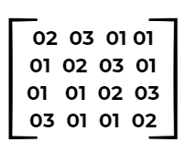
Step 3: MixColumns Transformation
The MixColumns step in AES applies a matrix multiplication over GF(2⁸)
(Galois Field), ensuring further diffusion of the data. Each column in the
state matrix is transformed independently.
In this field, addition is XOR (⊕), and multiplication follows modular arithmetic based on a fixed polynomial.

Slide 11
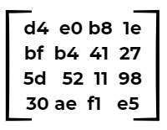
GF(2⁸) Multiplication Rules :
Multiplication by 1 → Value remains the same:
1×x=x1
Multiplication by 2 → Left shift by 1 bit; if MSB = 1, XOR with 0x1B:
2×x={(x<<1) if MSB = 0
(x<<1) ⊕ 0x1B if MSB = 1
Multiplication by 3 → Equivalent to (2 × x) ⊕ x:
3×x =(2×x)⊕ x
First Column :
(2⊗d4)⊕(3⊗bf)⊕(1⊗5d)⊕(1⊗30)
2⊗d4 =
1101 0100
1010 1000
1010 1000​⊕0001 1011 = b3​

Slide 12
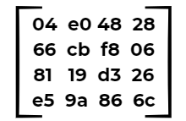
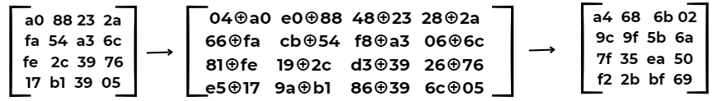
3⊗bf = (2⊗bf) ⊕ bf = (7e⊕bf) = c1
; 1⊗5d=5d ; 1⊗30=30
Now XOR all values : b3⊕c1⊕5d⊕30= 04
Applying this to all four columns, we get the final MixColumns matrix:
Step 4: AddRoundKey
Round key
Final Matrix

Slide 13
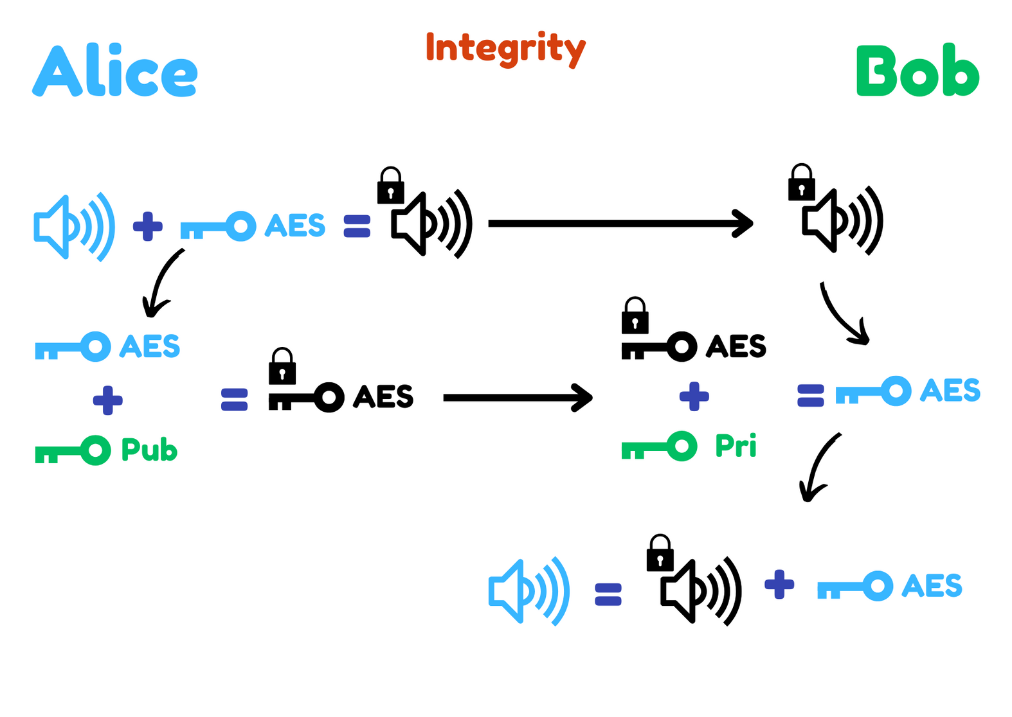

Slide 14
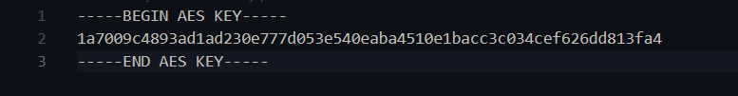
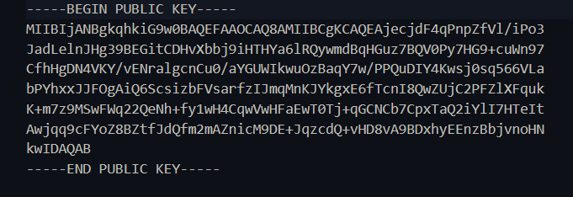
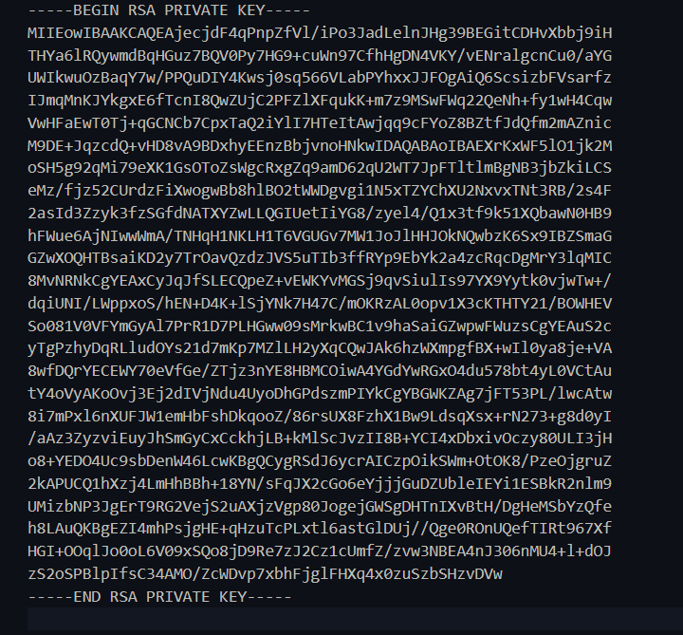

Slide 15
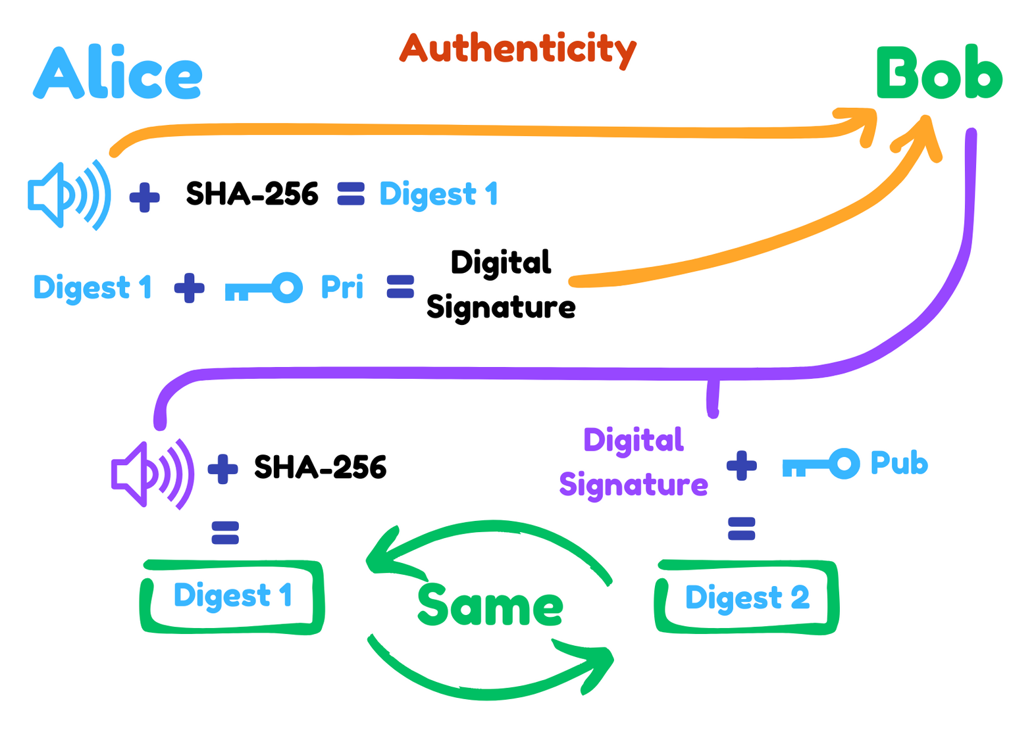

Slide 16
Kyber & Dilithium

Slide 17

Kyber: Post-Quantum Key Encapsulation
Introduction :
- Kyber is a lattice-based Key Encapsulation Mechanism (KEM) designed to secure key exchanges against both classical and quantum attacks.
- Leverages the Module Learning With Errors (MLWE) problem for robust security.
Key Features:
- Post-Quantum Security: Provides security even in a future with quantum computers.
- Efficiency: Offers low computational complexity and minimal latency, ideal for real-world applications including IoT and secure communications.
- Standardization: A strong candidate in the NIST post-quantum cryptography standardization process, ensuring that it meets rigorous security and performance standards.

Slide 18

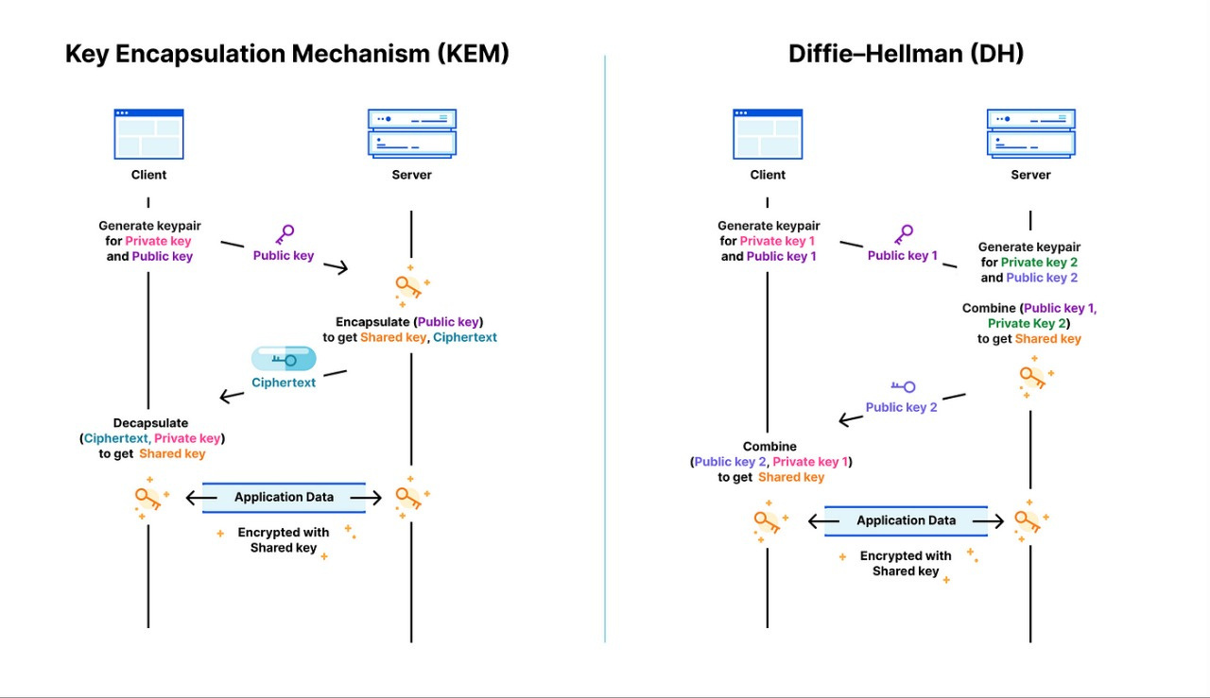

Slide 19
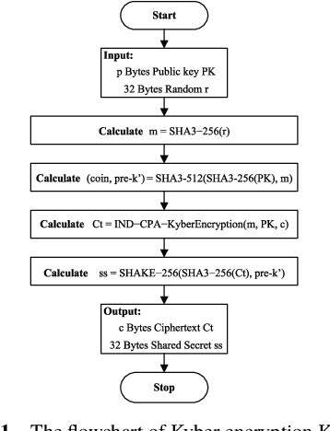
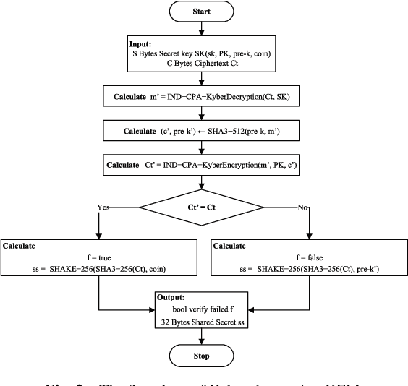

Slide 20
Dilithium: Post-Quantum Digital Signatures
What is Dilithium?
- A post-quantum digital signature scheme designed to secure digital communications.
- Based on lattice problems, ensuring security even in the face of quantum computing threats.
Key Features:
- Produces compact signatures with fast verification.
- Uses a combination of rejection sampling and the Fiat-Shamir transform for non-interactive signing.
- Also a finalist in the NIST post-quantum cryptography standardization process.

Slide 21
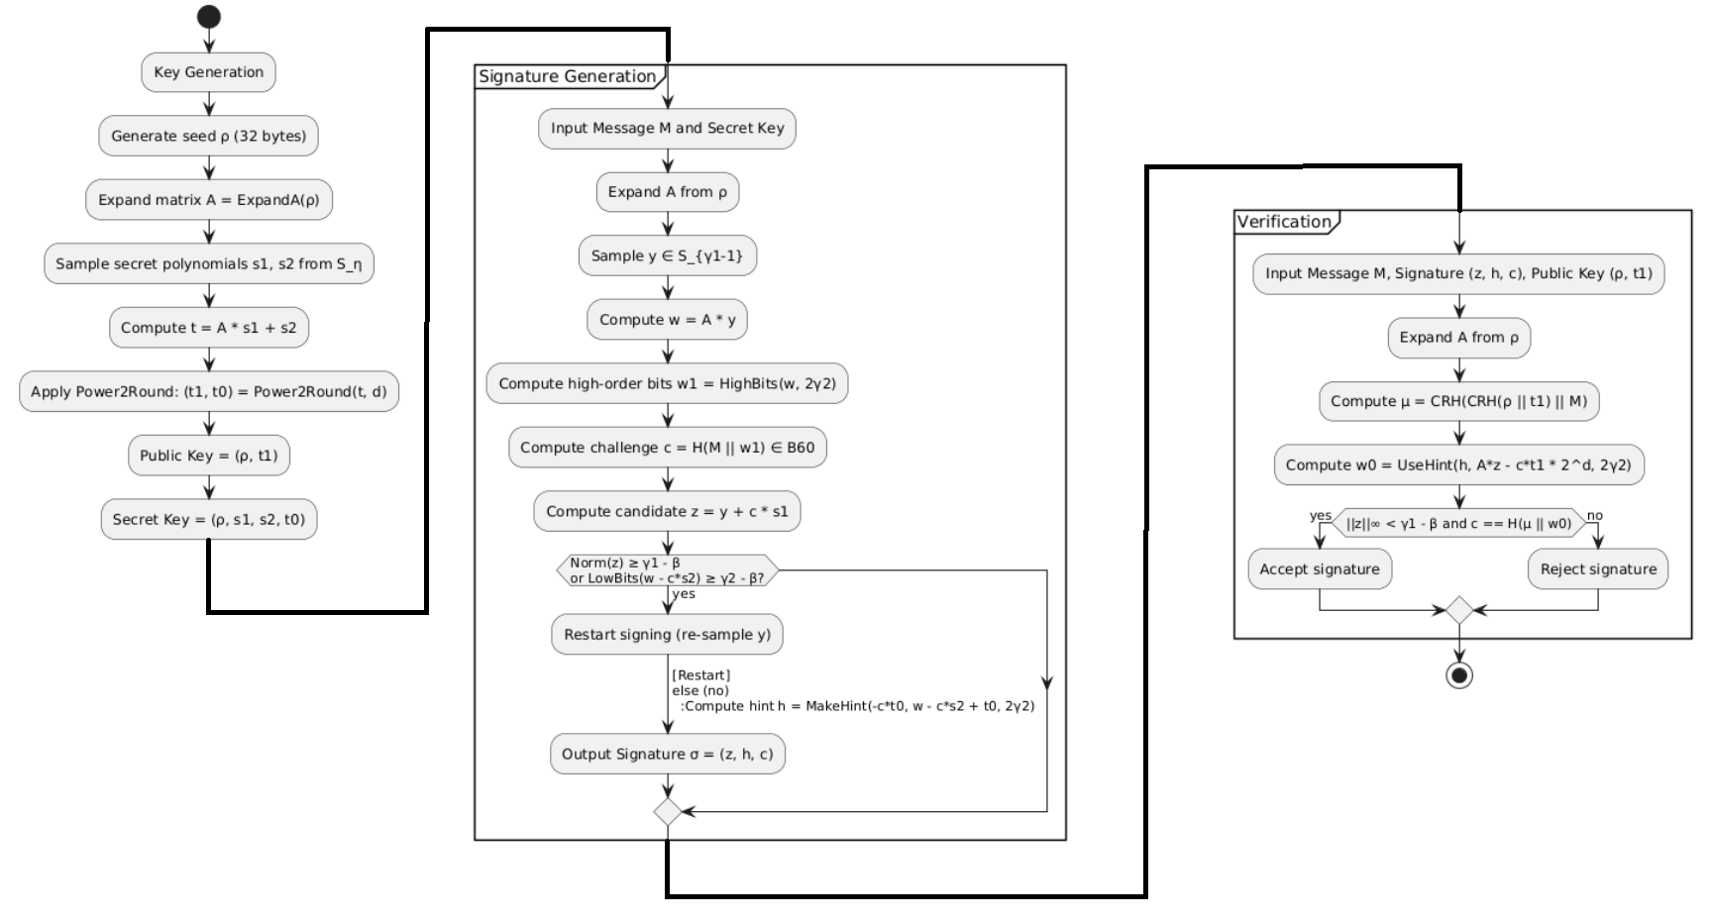

Slide 22
Demo : )

